Slide 1
REST API
Fundamentals
learn more

Slide 2
Agenda for today
Quick overview to the full program
Why API Automation is needed today?
Different Protocols and Architectures
RESTful API Fundamentals
Steps to test / automate the API
REST
GRAPHQL

Slide 3
2 API Architectures
1
REST
Representational state transfer (REST) is a software architectural style
REST
2
GRAPHQL
GRAPHQL
GraphQL is an open-source data query and manipulation language for APIs

Slide 4

Tools/Libraries that you will be learning
REST
1
PostMan
a collaboration platform for API development.
REST
RestAssured + WireMock
2
Java DSL framework for simplifying testing of REST based services
3
Swagger
REST
Framework backed by a large ecosystem of tools for documentation
Karate
Tool to do API test-automation, mocks

Slide 5
Applications Under Test (AUT)
ServiceNow
ITSM Application
01
JIRA
Project Management Application
02
Salesforce
03
CRM Application

Slide 6


Customized Abstracts - Frameworks
01
02
Matschie
Makaia
REST Assured +
Cucumber +
Allure
Rest Assured +
Selenium
+
Cucumber
+
Extent

Slide 7
Why API Automation is growing in demand?
API Based Apps
Faster
Easier & Isolated
Data Generation
Less Failures
01
02
03
04
05

Slide 8
Why API Automation is growing in demand?
API Based Apps
01

Slide 9
Why API Automation is growing in demand?
Faster
02

Slide 10

Rendering Engine

Slide 11
Why API Automation is growing in demand?
Easier & Isolated
03

Slide 12

Browser Specific

Slide 13
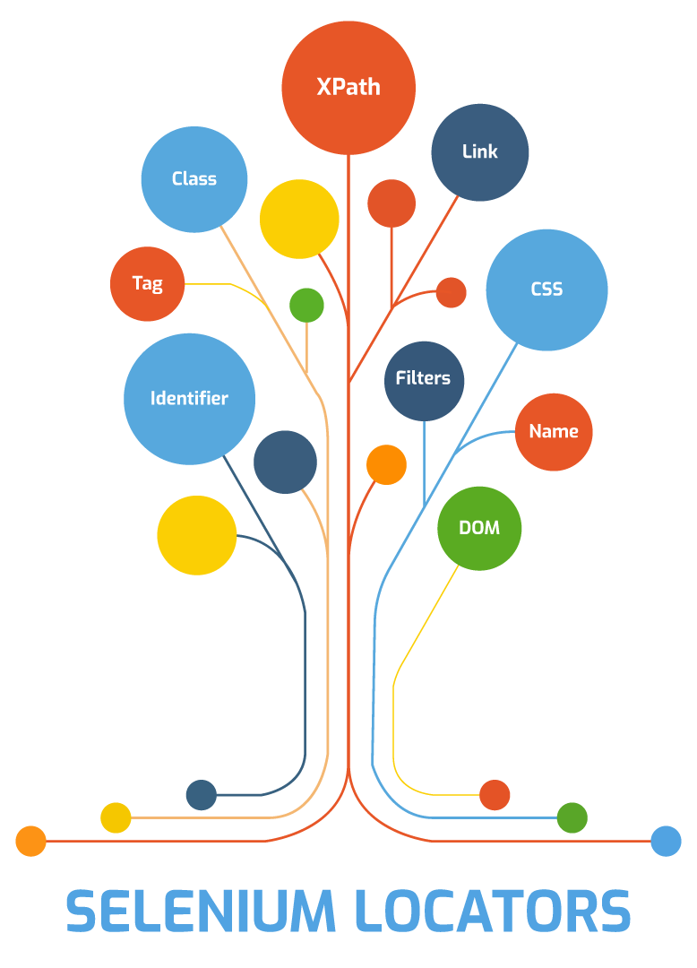
Element Challenges

Slide 14
Why API Automation is growing in demand?
Data Generation
04

Slide 15
Why API Automation is growing in demand?
Less Failures
05

Slide 16

Element Not Found Challenges

Slide 17
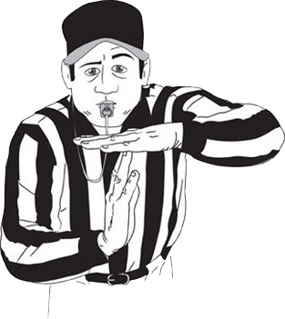
Time Out (Behavioral) Failures

Slide 18
Summary !!
API Based Apps
Faster
Easier & Isolated
Data Generation
Less Failures
01
02
03
04
05

Slide 19
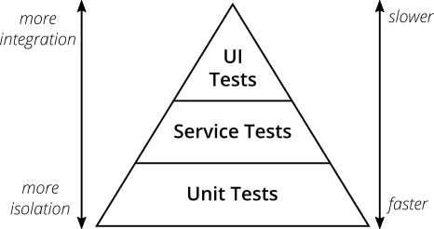
Mike Cohn’ Test Pyramid

Slide 20
Test Pyramid - Take Away
Write tests with different granularity (End to End tests in UI)
2. The more high-level you get the fewer tests you should have

Slide 21
What is API?

Slide 22
What is API?
API stands for Application Programming Interface
API is a set of rules and protocols that enables the communication between different software applications.
The simple real-time analogy to understand what an API is “Customer-Waiter-Chef” analogy.

Slide 23
Types of Web APIs
RESTful API (REpresentational State Transfer)
SOAP API (Simple Object Access Protocol)
GraphQL
JSON – RPC and XML – RPC
OData (Open Data Protocol)
gRPC (Remote Procedure Calls)

Slide 24
SOAP vs REST vs GraphQL
SOAP - Simple Object Access Protocol (1998)
REST - Representational State Transfer (2000)
GraphQL – Graphical Query Language (2015)

Slide 25
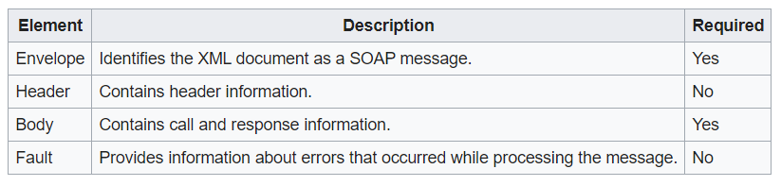
SOAP
1998
SOAP (Simple Object Access Protocol) is a messaging protocol specification for exchanging structured information in the implementation of Web Services.
XML
GET, POST
Higher Payload
No Cache

Slide 26
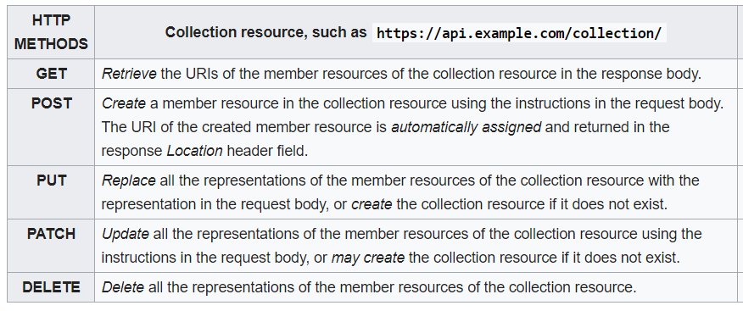
REST
2000
Representational state transfer (REST) is a software architectural style that defines a set of constraints to be used for creating Web Services
XML, JSON, TXT, HTML
GET, POST, DELETE
PUT, PATCH, HEAD ..
Lower Payload
Stateless, Cache

Slide 27
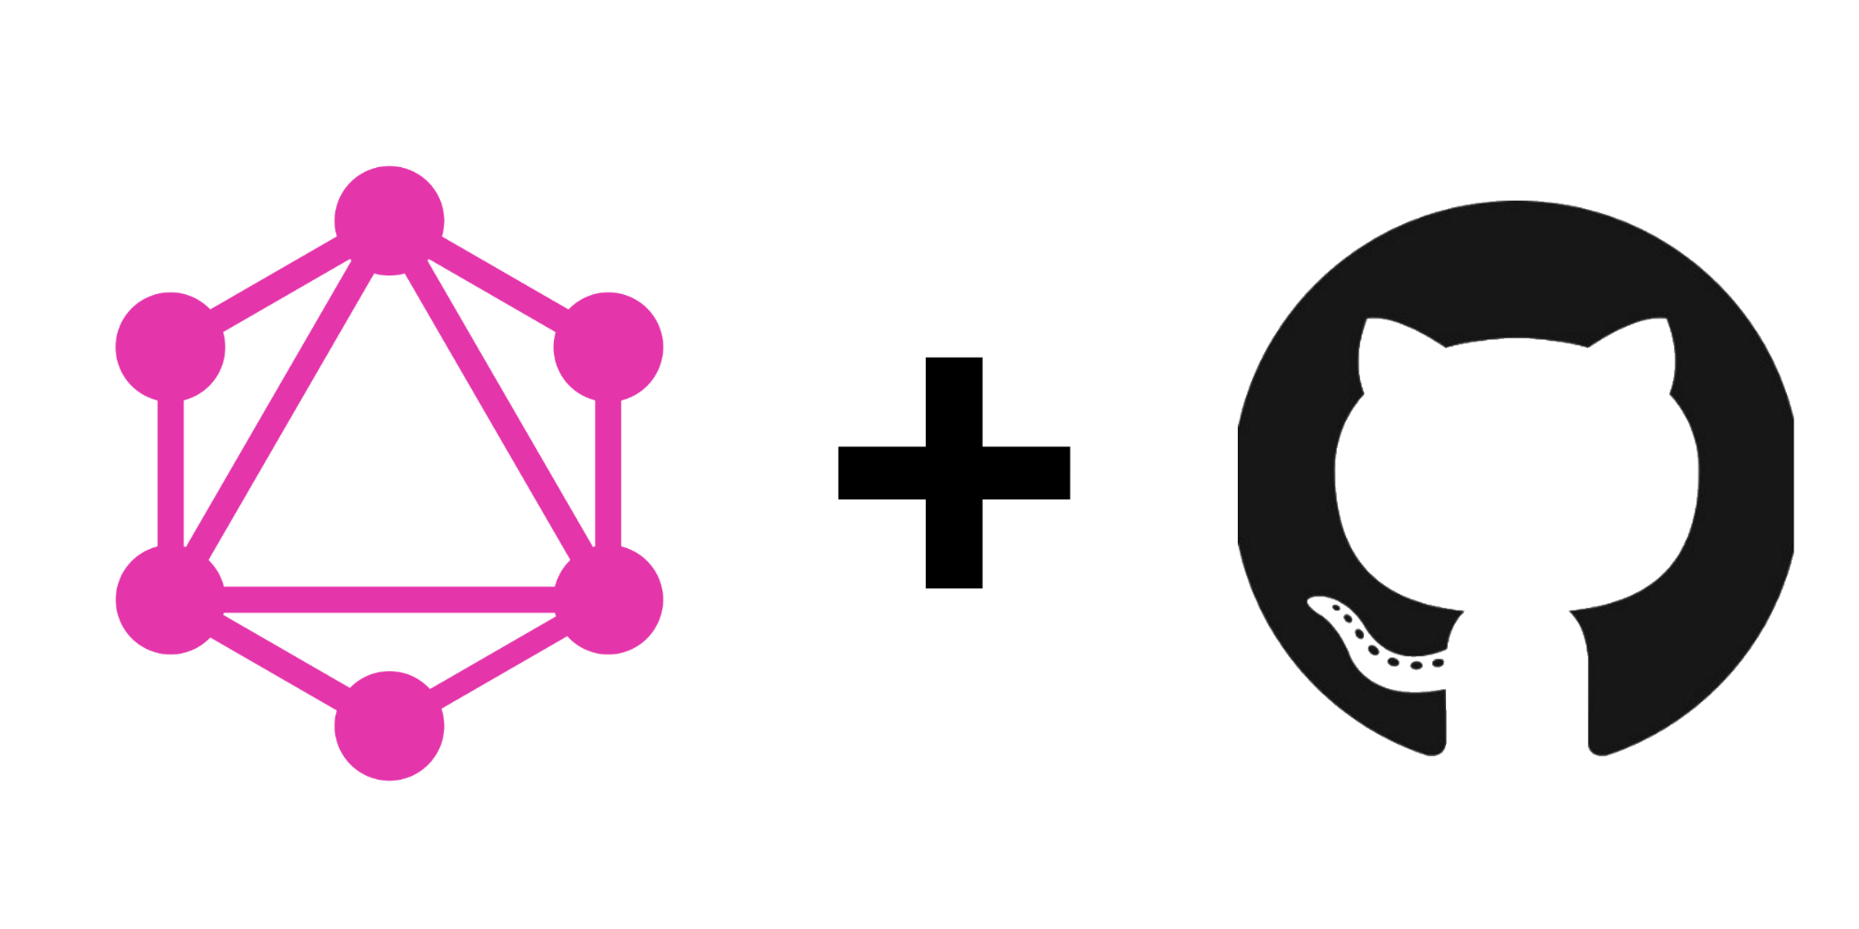
GraphQL
2015
GraphQL is an open-source data query and manipulation language for APIs, and a runtime for fulfilling queries with existing data
JSON
Asynchronous
HTTP, AMQP, MQTT
Send Only required data

Slide 28
HTTP Methods (CRUD)
1
2
3
4
5
GET
POST
DELETE
PUT
PATCH
Retrieve resource information
(READ)
Create new subordinate resources
(CREATE)
delete resources
(DELETE)
primarily to update existing resource
(REPLACE)
make partial update on a resource
(UPDATE)

Slide 29

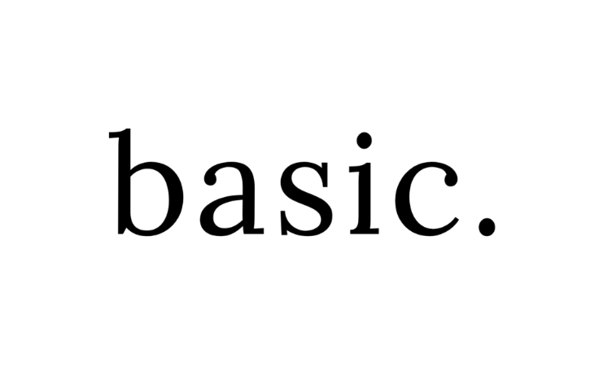

Authentication
No Authentication
Basic
OAuth 2.0
Token
Examples: Weather Forecast, Google Map
Examples: ServiceNow,
JIRA
Examples: Payment Gateways, ServiceNow
Examples: Oracle WMS,
JWT

Slide 30
Request Parameters
Header
Request header, usually related to authorization.
Query
Parameters in the query string of the endpoint, after the ?.
Form / Request Body
Parameters included in the request body. Usually submitted as JSON.
Path
Parameters within the path of the endpoint, before the query string (?). These are usually set off within curly braces.

Slide 31
Request Parameters – Data Types
These data types are the most common with REST APIs:
string: An alphanumeric sequence of letters and/or numbers
integer: A whole number — can be positive or negative
boolean: true or false value
object: Key-value pairs in JSON format
array: A list of values
Header
Query
Form
Path

Slide 32
HTTP Headers
Content-Type
Accept
The Content-Type entity-header field indicates the media type of the entity-body sent to the recipient. (request)
The Accept request-header field can be used to specify certain media types which are acceptable for the response.

Slide 33
Request Body (Data Formats)
Form Data
Form (URL Encoded)
Form Data
Form
(URL Encoded)
In Key-value format (Text / File) including multi-part
Data is encoded in key-value format
None
Body
Contents
Raw Data
No
Contents
Raw
(JSON/XML)
No data passed in body
This can be JSON/ XML or TXT
Queries & Variables
Binary
Queries
(GraphQL)
Binary
Content
This is specially for the GraphQL Scenarios
The files or executables that can be attached

Slide 34
HTTP Response
HTTP Response has 4 components:
Response Status Code: This represents the server response status code for the requested resource. Example:- 4xx represents client error, 2xx represents a successful response.
HTTP Version: Indicates the HTTP protocol version.
Response Header: This part has the metadata of the response message. Data can describe what is the content length, content type, response data, what’s server type, etc.
Response Body: This part contains what’s the actual resource/message returned from the server.

Slide 35

Status Codes
100 -199
200 - 299
300 - 399
400 - 499
500 - 599
Information
Success
Redirects
Clients Errors
Server Errors

Slide 36
Body (Contents)
The body can have different formats like below:
JSON
01
JSON - JavaScript Object Notation
XML - Extensible Markup Language
TXT – Plain text format
TXT
XML
03
02

Slide 37
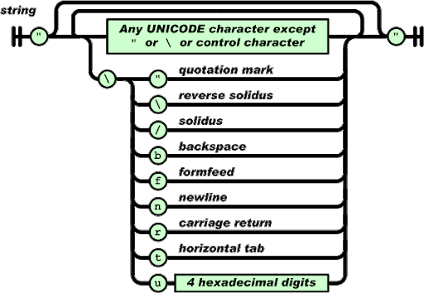
JSON – A quick run through
JavaScript Object Notation
Lightweight
Easy to understand
Not specific to languages

Slide 38
JSON Structure
Simple JSON format
Simple JSON Array
{
“name”: "Babu",
“age”: 45,
“city”: "Chennai"
}
{
“name”: "Babu",
“age”: 45,
“companies”: ["Syntel", "HCL", "HP", "TL"]
}

Slide 39
JSON Nested Arrays
{
"name":"Babu",
"age":45,
"companies":[
{"name" : "syntel", "years" : "3.1", "customers" : 4, "country" : ["india", "usa"]},
{"name" : "hcl", "years" : "1", "customers" : 1, "country" : ["india"]},
{"name" : "hp", "years" : "13.2", "customers" : 18, "country" : ["india", "usa","uk","sg"]},
{"name" : "tl", "years" : "4.3", "customers" : 8, "country" : ["india", "usa"]}
]
}

Slide 40
XML Structure
Simple XML
<?xml version="1.0" encoding="UTF-8"?>
<details>
<person>
<name>Babu</name>
<age>45</age>
<city>chennai</city>
</person>
</details>

Slide 41
5 Step Process
Add Request
Headers + Authorization + Request Query / body
End Point
Send Request
Server + Port + Resources
Send to the server with the appropriate request type
03
STEP
02
STEP
04
STEP
Requirement
Validate Response
Swagger / PostMan Documentation
01
STEP
05
STEP
Verify with status code and body
START

Slide 42

Documentation Tool
https://covid-19-apis.postman.com/

Slide 43
Thank You!

